Slide 1






Slide 2
Home/
school
Birthdays
Festivals
Signs
Time
Holidays
TV
Food
$100
$100
$100
$100
$100
$200
$200
$200
$200
$200
$300
$300
$300
$300
$300
$400
$400
$400
$400
$400

Slide 3

$100
What’s your favourite
subject?

Slide 4
$200
Home vs. School
Talk on the phone
Sweep the floor
Study Math
Play football
Set the table
Listen to music
Study Math

Slide 5
$300
Add a word to these words
Wash ______
Set ________
Cook _______
Listen to ____
Watch_____
Water ______
Sweep ______

Slide 6
$400
What subject teaches us …?
Numbers
ABC
Drawing
The guitar

Slide 7

$100
When is your birthday?

Slide 8
$200
Give the ordinal numbers
= 1st first
= 2nd second
=
=
=
=
=
=
=
=
=
=

Slide 9

$300
What are the 12 months of a year?

Slide 10
$400
When is Christmas?
When is Valentine’s Day?
When is Halloween?

Slide 11


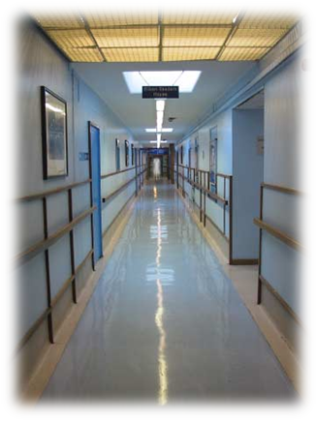




$100
What does the sign say?
corridor

Slide 12



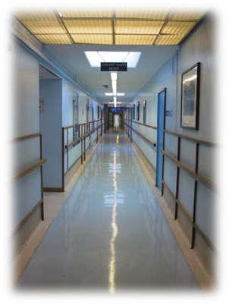
$200
Make the rules

Slide 13





$300
What’s the time on the clocks?

Slide 14



$400
What time is it?

Slide 15

$100
What festival is on December 25th?

Slide 16
$200
What 4 things can we do at Halloween?

Slide 17

$300
What are 5 programs we can watch on TV?
Which do you like and why?

Slide 18

$400
When is Halloween?
What do Children say at Halloween?
What do we do at Christmas?
What do we eat at Easter?

Slide 19


$100
May I have a ___ of _____, please?

Slide 20
$200
I want to drink water.
I’m ________.
I want to eat.
I’m _______.
I don’t want to eat.
I’m ______.

Slide 21



$300
Please give me a _____
Please give me a _____
Please give me a _____

Slide 22
$400
I want a ___ of soup.
May I have a ___ of coffee?
I want a ____ of chocolate.

